Slide 1
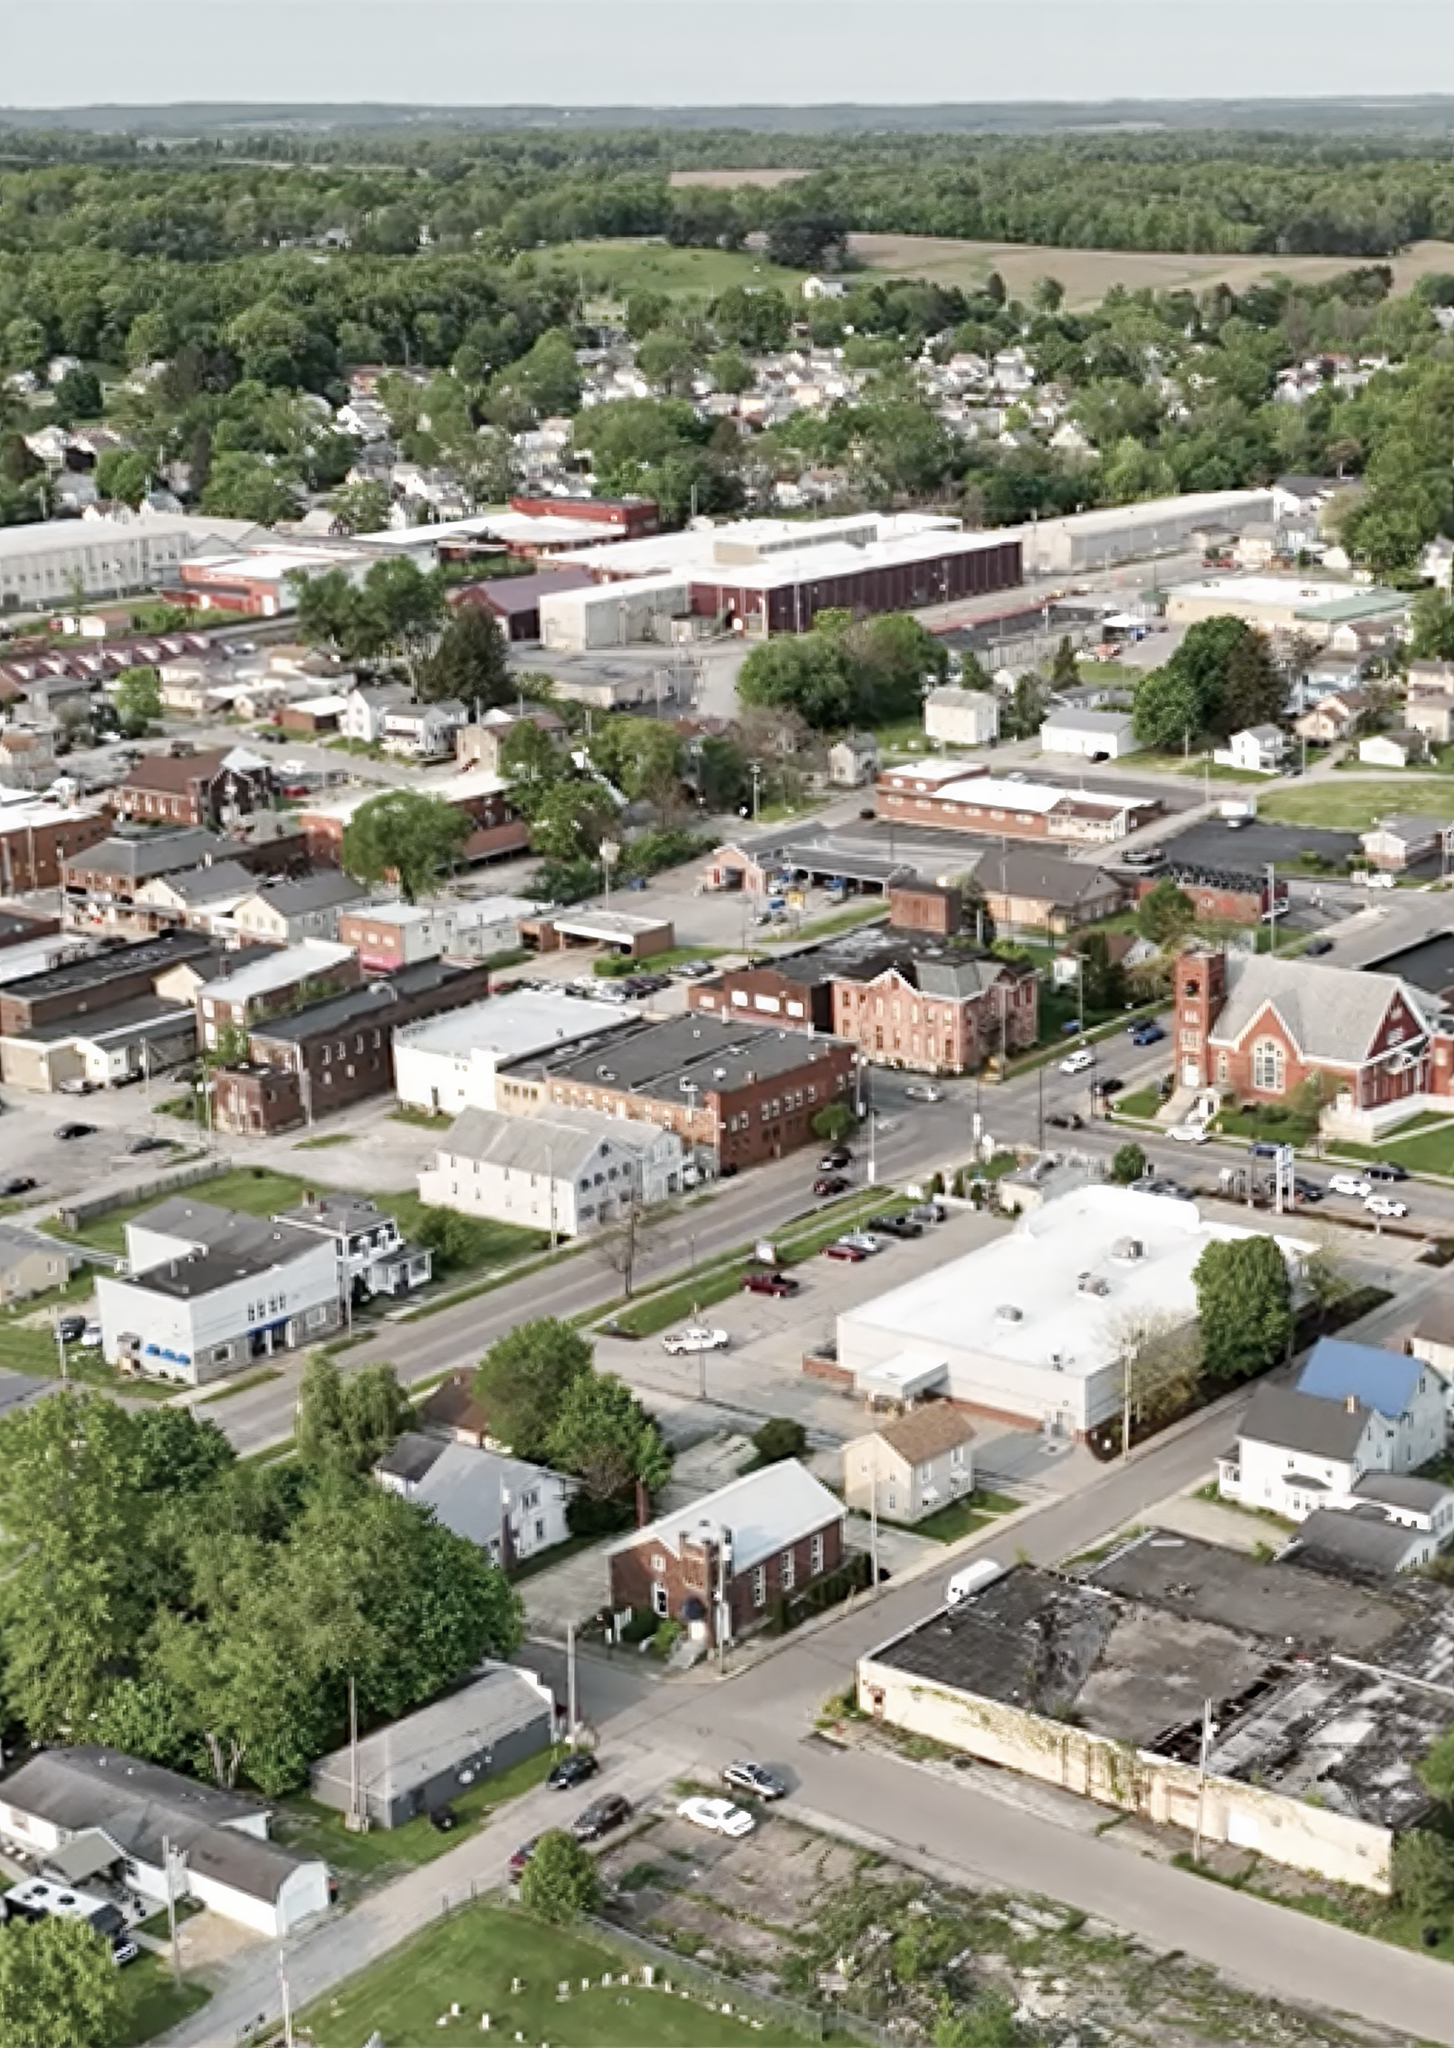











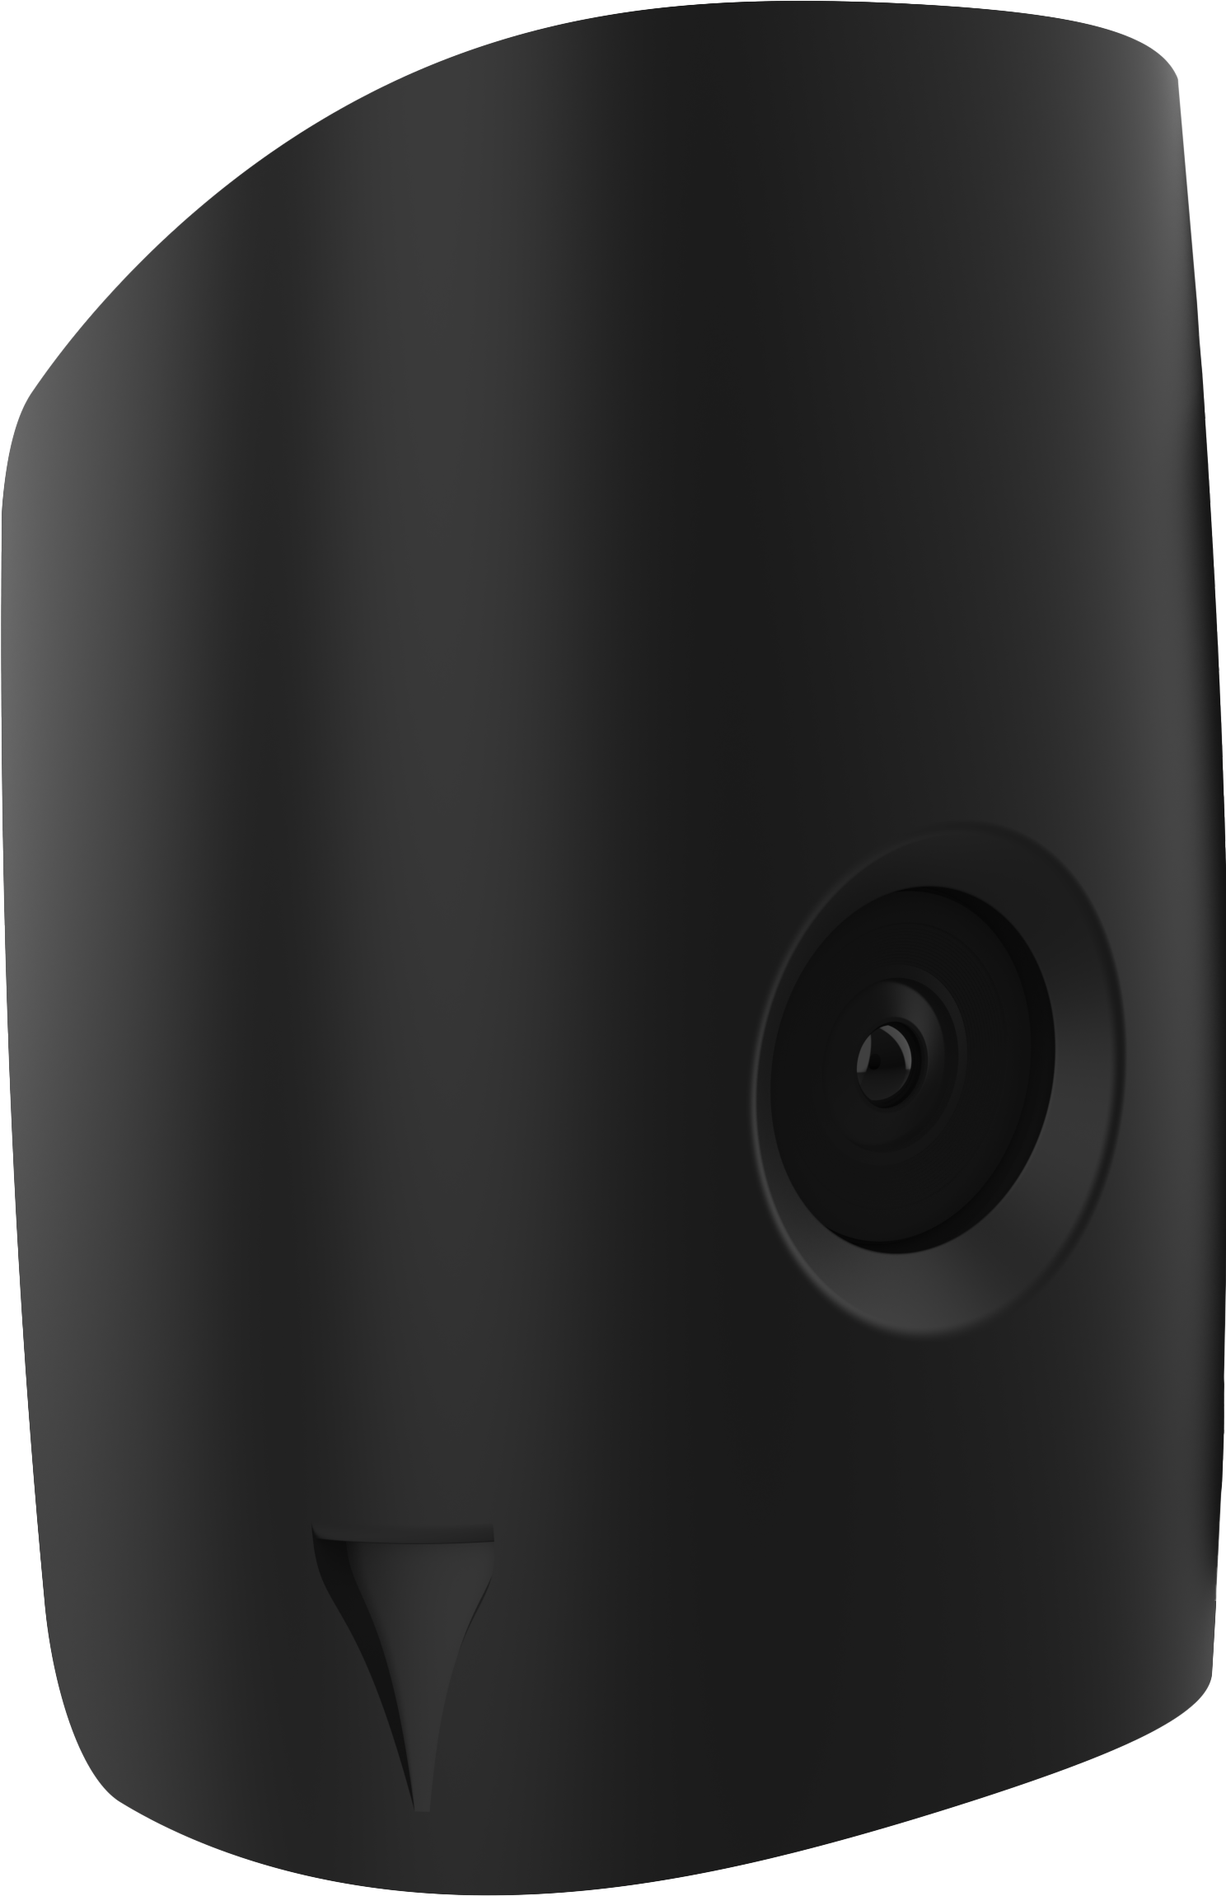
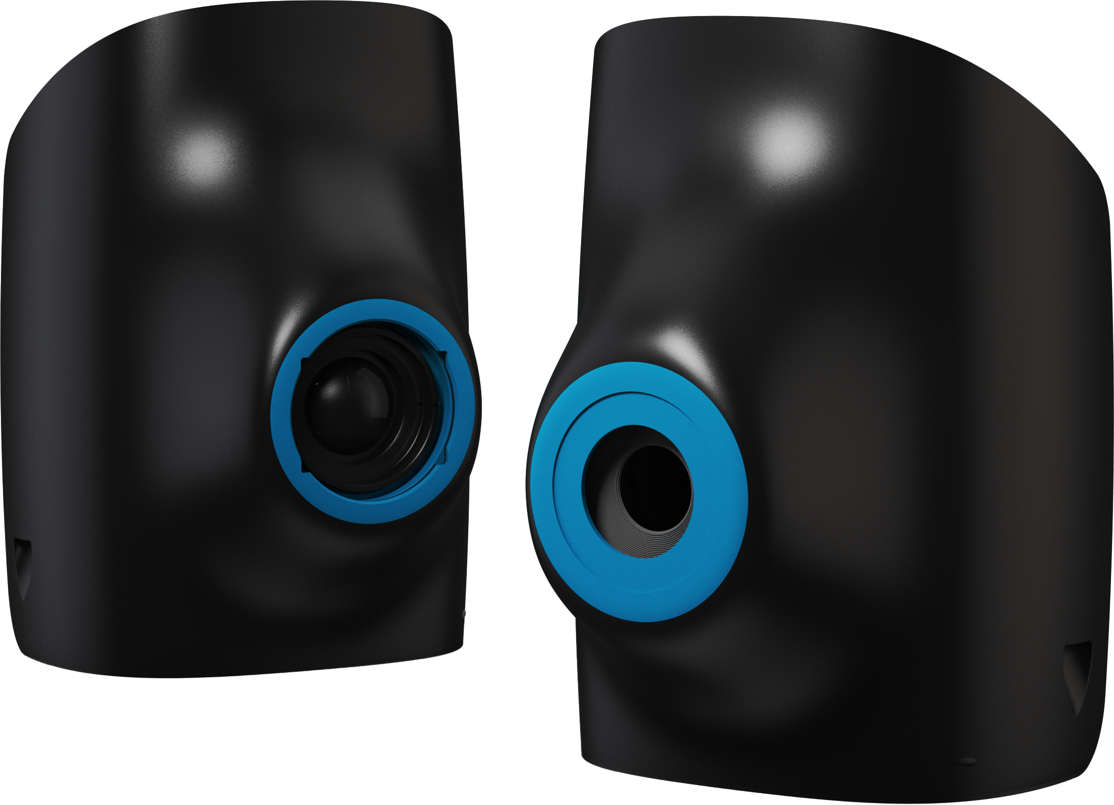
Digital mapping in east palestine, ohio
Specifications
38
GSD
WIND SPEED
MISSION DURATION
18mm gsd for Sony LR1, 3mm for Phase One P5
8.5m/s or 20mph
7 hours of total flying (over 2 days)
Cleartopia Solutions™ is a U.S.-based drone solutions provider specializing in advanced aerial hardware, software, and strategic support for public and private sector clients. The company focuses on delivering next-generation tools that enhance safety, planning, and innovation.
TEMPERATURE
IMAGES TAKEN
AREA SURVEYED
30° C
10000+
5,000+ acres
In August 2025, Cleartopia conducted a large-scale aerial mapping mission for the Village of East Palestine, Ohio, in support of recovery and redevelopment efforts following the Norfolk Southern train derailment that occurred in February 2023. The incident prompted long-term environmental and infrastructure planning initiatives, where accurate aerial data became essential to rebuilding community trust and safety. Using the Quantum Systems Trinity Pro, the team created the most comprehensive and detailed digital map of the village to date.
UAS DEPLOYED
CAMERA
ALTITUDE
Trinity Pro
Sony ILX-LR1 and Phase One P5
400ft altitude
Sony ILX-LR1
The Sony ILX-LR1 RGB camera combines 61 MP resolution with advanced sensor technology to deliver exceptional image quality and coverage. Fully integrated with the Trinity Pro, it offers customizable settings for any mission — balancing high accuracy with efficient data capture and streamlined workflows.
Phase One P5
The Phase One P5 is a 128 MP medium-format survey-grade camera that delivers outstanding image detail and absolute accuracy down to 0.5 cm RMS. Paired with the Trinity Pro, it enables large-area mapping with precision and reliability, reducing time and costs for high-end surveying applications.
CHALLENGES
The Village of East Palestine faced the need for cost-effective, high-resolution mapping to support long-term recovery, infrastructure planning, and environmental monitoring. Traditional aerial mapping, often requiring fixed-wing aircraft, can cost up to $75,000 per project and involve long turnaround times. For a small community recovering from a disaster, this approach was neither financially nor operationally sustainable.
OHIO, USA
The East Palestine Mapping Project
Platform and Camera:
Sony ILX-LR1 and Phase One P5
OUR SOLUTION
Delivering 5,000 Acres of High-Resolution Mapping with Trinity Pro & Sony ILX-LR1 and Phase One P5
Cleartopia deployed the Quantum Systems Trinity Pro eVTOL UAV to conduct large-scale aerial mapping of East Palestine. Using Trinity Pro’s long endurance and survey-grade payload, the team was able to map more than 5,000 acres in just two days, producing over 500GB of actionable data — at a fraction of the cost of traditional aerial mapping solutions, which can run up to $75,000 per project.
This provided East Palestine with the foundation for a comprehensive digital map that municipal staff could directly use for planning, safety, and recovery operations.
QUANTUM SYSTEMS USE CASE
01

Slide 2
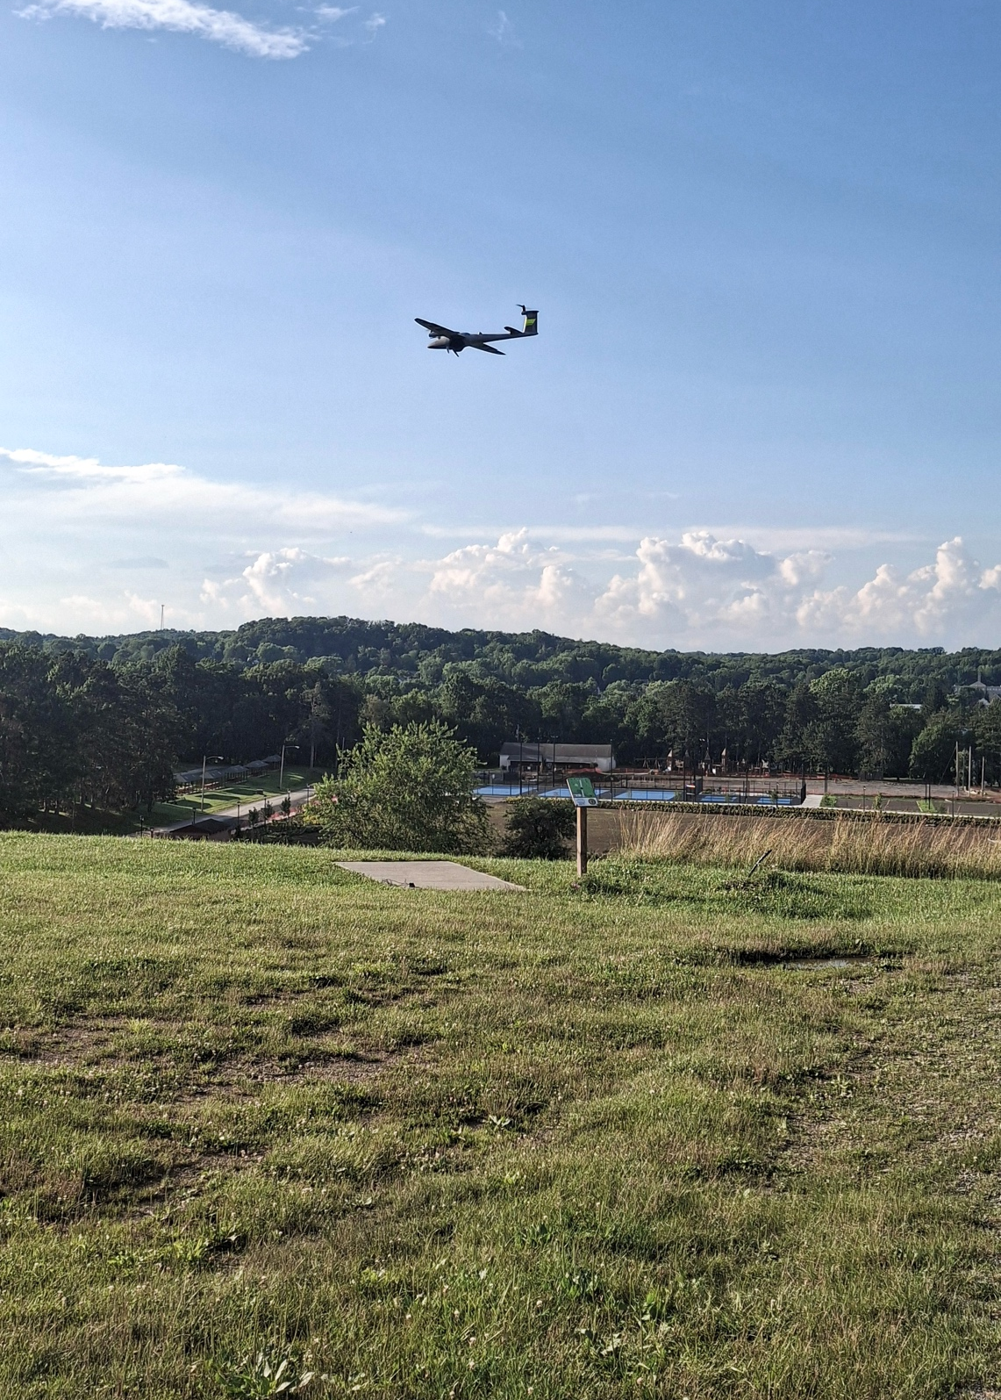
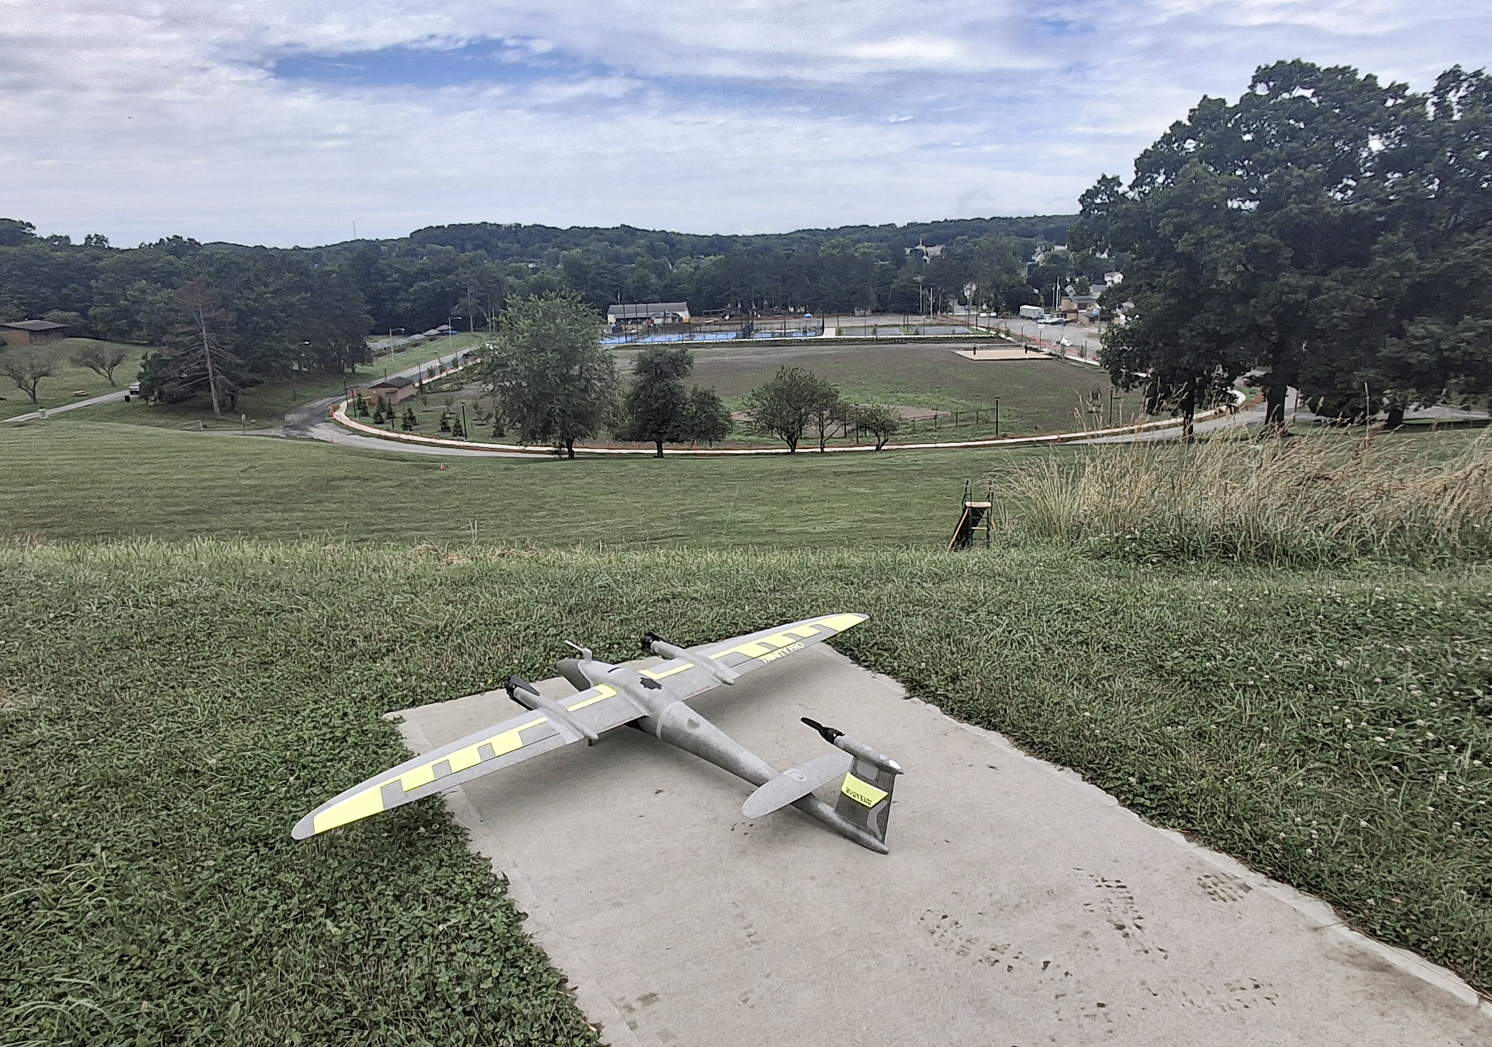
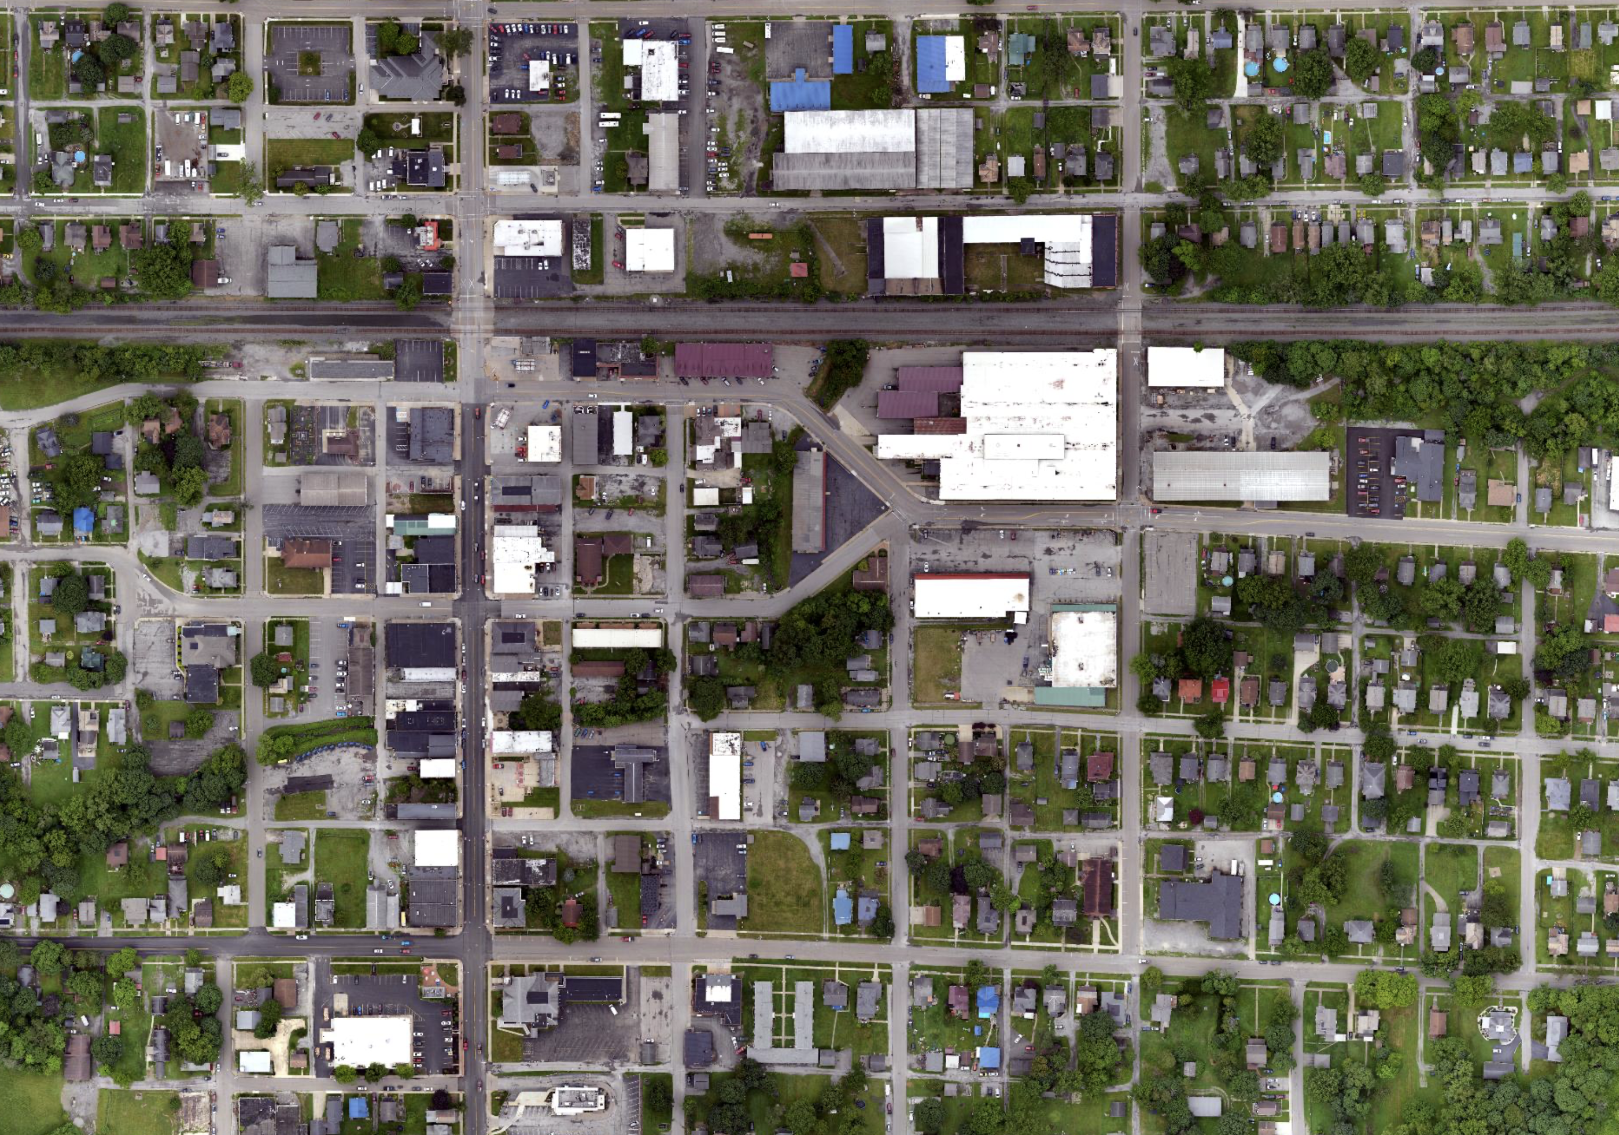
Mapping over 5,000 acres with trinity pro in just 2 days
MISSION EXECUTION
RESULTS AND BENEFITS
FROM COST SAVINGS TO COMMUNITY GROWTH
The Trinity Pro was flown by Cleartopia Solutions over the Village of East Palestine with town approval and full compliance with FAA regulations. Flights were conducted with visual observers positioned throughout the area to maintain Visual Line of Sight (VLOS).
The project area was divided into multiple flight zones to ensure safe operations and complete coverage. In total, Cleartopia mapped over 5,000 acres in just two days, collecting more than 500GB of high-resolution data — all provided to the city at no cost as part of Cleartopia’s community support initiative.
The mission produced a highly detailed digital map of East Palestine, with orthomosaic imagery at 1.8 cm GSD, along with a contour map, DSM, and point cloud. This data is already being used by the Village for:
Park development planning
Paving schedule optimization
Environmental recovery projects
The Village now owns the full dataset, which can be reused across multiple projects and departments. Future re-flights can also build on this baseline, ensuring consistent comparisons over time.
The East Palestine project highlights the return on investment of UAV-based mapping:
Cost savings: Traditional aerial mapping (~$75,000) vs. drone solution (~$20,000).
Efficiency: Thousands of acres mapped in 2 days, delivering immediate outputs.
Community impact: Baseline data empowers recovery, infrastructure planning, and education initiatives.
Future plans: Continued use of Trinity Pro and Cleartopia drone solutions for municipal decision-making, emergency response, and training the next generation.
CONCLUSION:
The East Palestine mission demonstrates how small communities can leverage Quantum Systems’ Trinity Pro to gain the same level of aerial intelligence as major cities. This is being done at a fraction of the cost, driving smarter recovery, safer communities, and new opportunities in education.
The project also reflects how private-sector drone providers can collaborate with local governments in times of crisis, offering advanced aerial mapping capabilities at no cost to support recovery, transparency, and long-term community planning.
Voice of the user
Trent Casi
Co-Founder, Cleartopia Solutions
"The Quantum Systems Trinity eVTOL is going to be the perfect mapping platform for local governments to get this type of accurate and high-fidelity data with its reliability, ease of use, and robust sensor options as well."
QUANTUM SYSTEMS USE CASE
02

Slide 3
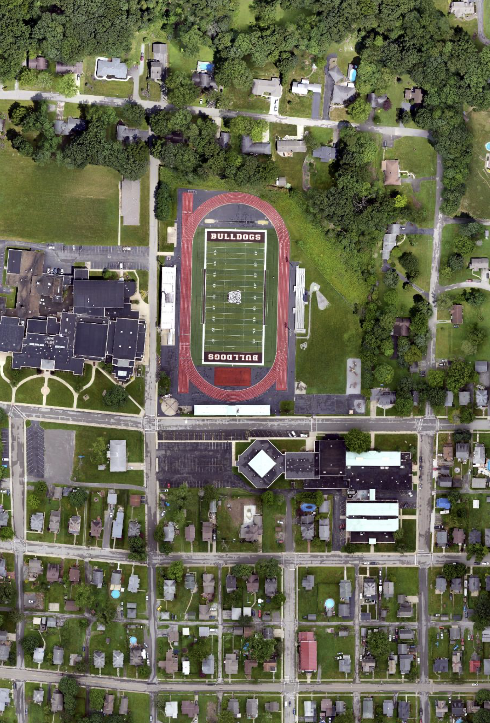
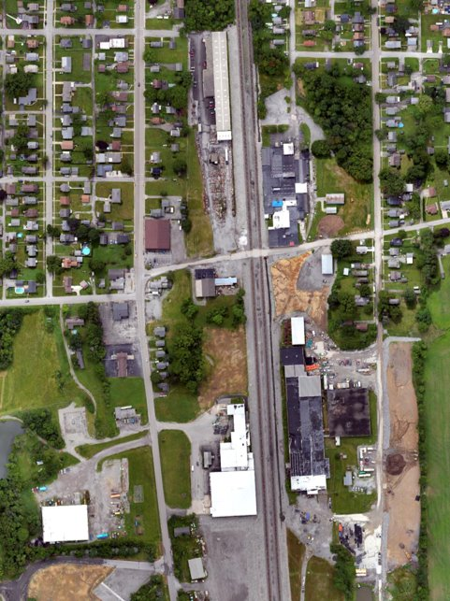
DATA PROCESSING
AND RESULTS
The baseline dataset generated with Trinity Pro is already supporting city planning, economic development, park design, paving schedules, and environmental recovery initiatives in East Palestine.
Data deliverables — including orthomosaics, DSMs, and layered vector maps- were processed using ESRI web-based systems, ensuring that all departments can access and use the information collaboratively.
The City Planning and Economic Development departments are the primary users of the data, integrating it into long-term infrastructure and redevelopment planning. This centralized access enables faster, data-driven decision-making across projects and reduces reliance on external surveys.
As new projects emerge, the dataset can be updated and reprocessed to reflect changes in the city landscape, ensuring that the mapping remains a living reference for recovery, planning, and growth.
ABOUT
QUANTUM SYSTEMS
Quantum Systems specialises in the development, design, and production of small Unmanned Aerial Systems (sUAS). The company’s range of electric vertical take-off and landing (eVTOL) sUAS are built to maximize range and versatility and to provide operators with a seamless user experience.
By integrating cutting-edge software capabilities, like edge computing and real-time AI-powered data processing, Quantum Systems is building next-generation UAS for clients in defence, security, public sectors.
Quantum-Systems was founded in 2015 and is headquartered at Special Airport Oberpfaffenhofen, 20 km west of Munich. For more information about Quantum-Systems visit www.quantum-systems.com.
3.
4.
Copyright © 2025 Quantum-Systems GmbH. All rights reserved.
Quantum-Systems GmbH | Zeppelinstr. 18 | 82205 Gilching | Germany
quantum-systems.com
03

